Slide 1
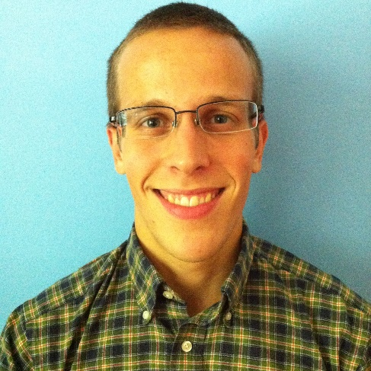
Optimal Itinerary
Sudesh Akrawal Melissa Lee Paul Ruess

Slide 2
Introduction
“For any US city, how can I maximize returns on my limited stay?”
Why it matters…
Travel planning – which attractions can easily be packaged together?
Hotel companies – best locations to build hotels?

Slide 3
Approach
Shortest path problem
Nodes:
Tripadvisor attraction reviews
Yelp restaurant reviews
Edges:
Open Street Map transportation network

Slide 4
Approach
Shortest path problem
Nodes:
Tripadvisor attraction reviews
Yelp restaurant reviews
Edges:
Open Street Map transportation network

Slide 5
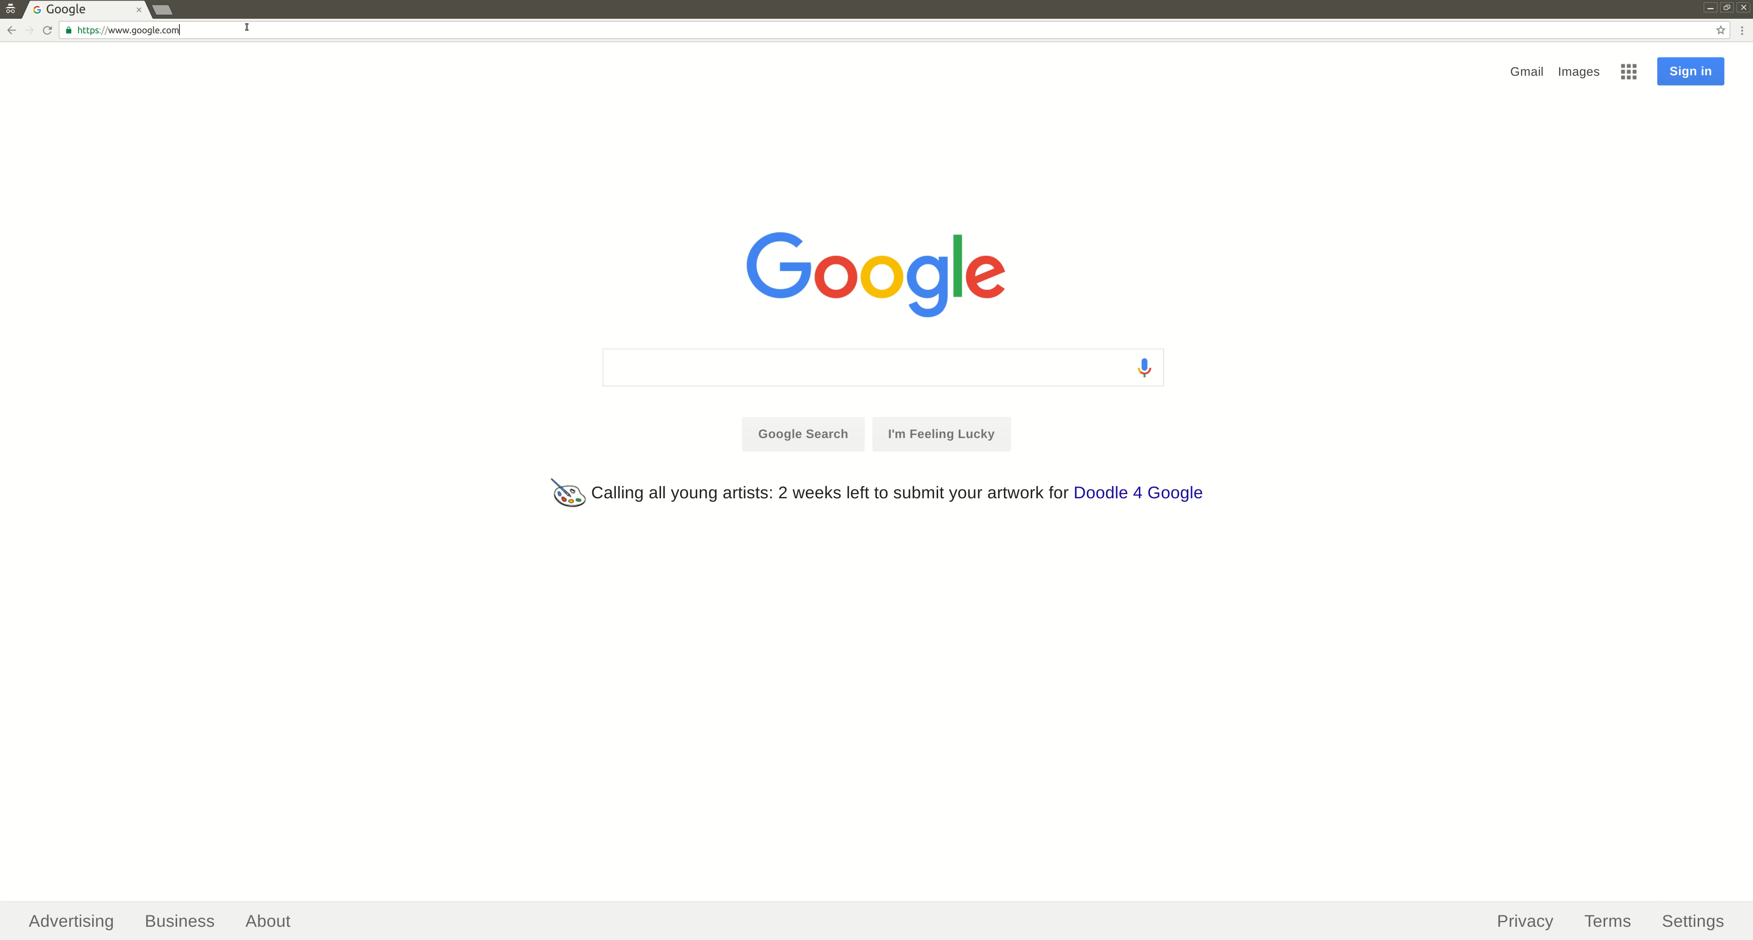
Nodes – Scraping TripAdvisor
https://scrapy.org/

Slide 6
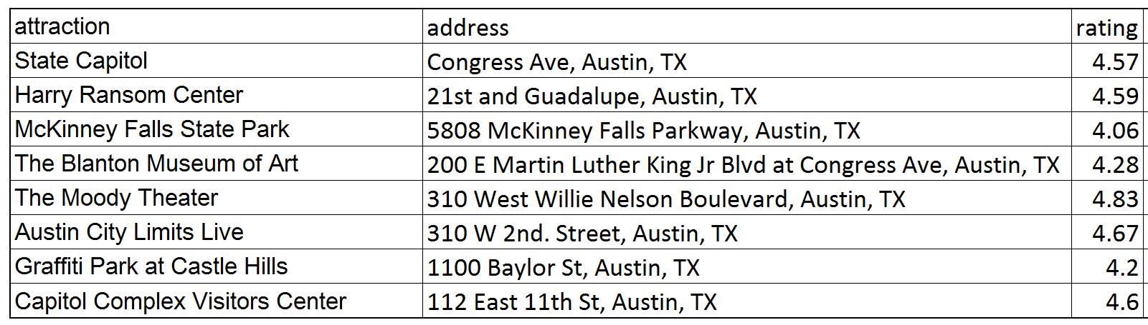
Nodes – Read as Pandas DataFrame
Scrapy Item Exporters → “CSV” option

Slide 7
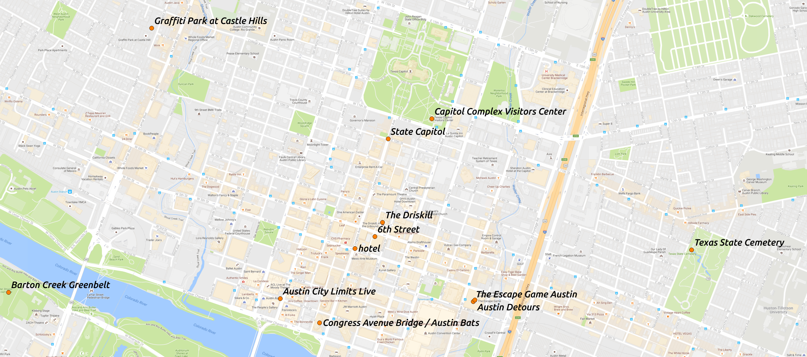
Nodes – Geocoding Attractions
Geocoder → Addresses to Lat/Lon coordinates
https://pypi.python.org/pypi/geocoder

Slide 8
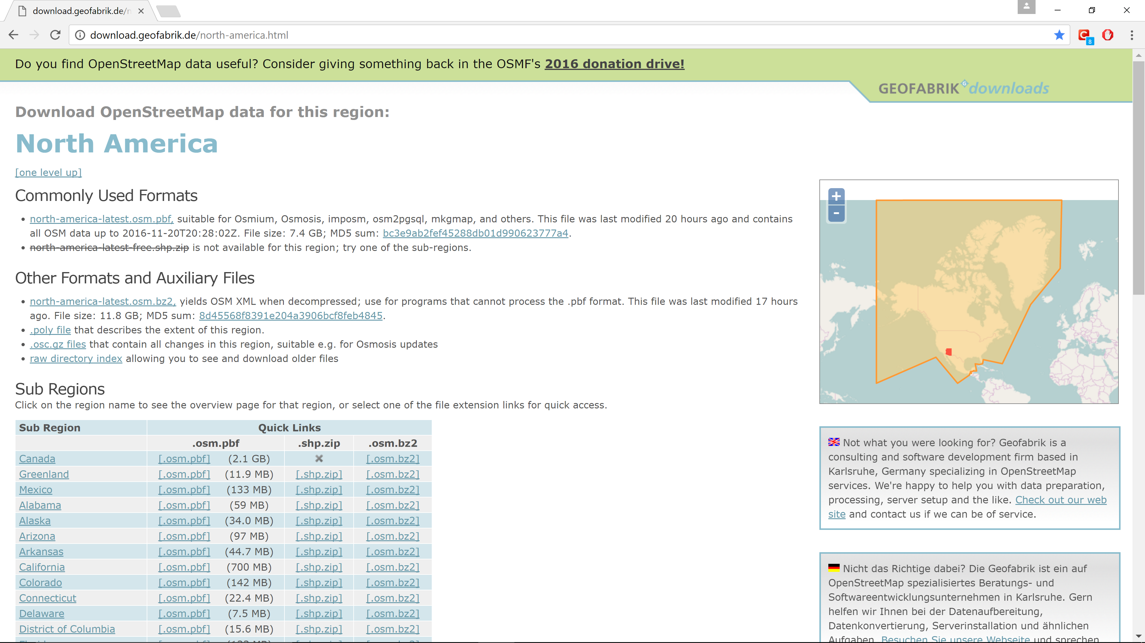
Edges – Data Retrieval
http://download.geofabrik.de/north-america.html

Slide 9
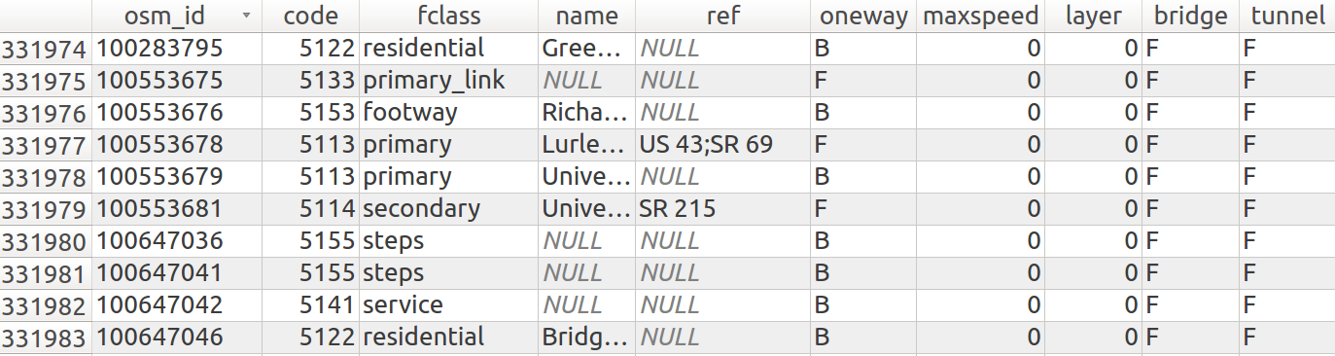
Edges – Pre-processing with PyQGIS
Raw data
Coordinate system: World Geodetic System 1984 (WGS84)
http://docs.qgis.org/testing/en/docs/pyqgis_developer_cookbook/

Slide 10
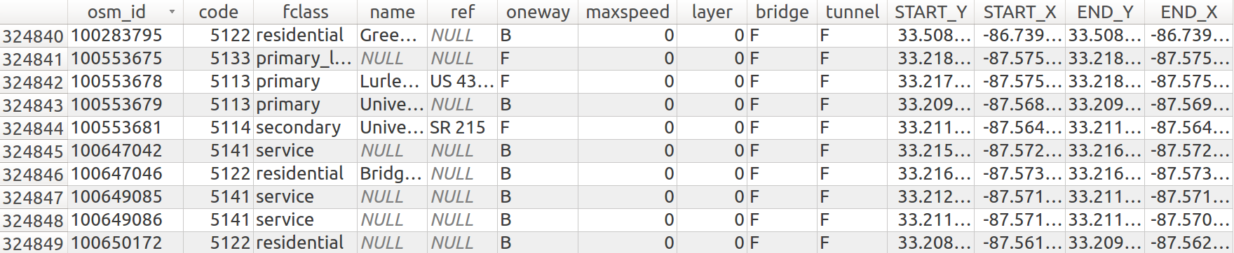
Edges – Pre-processing with PyQGIS
Select relevant roads by ‘fclass’ attribute
Retrieve latlon coordinates for each road’s start/end nodes

Slide 11
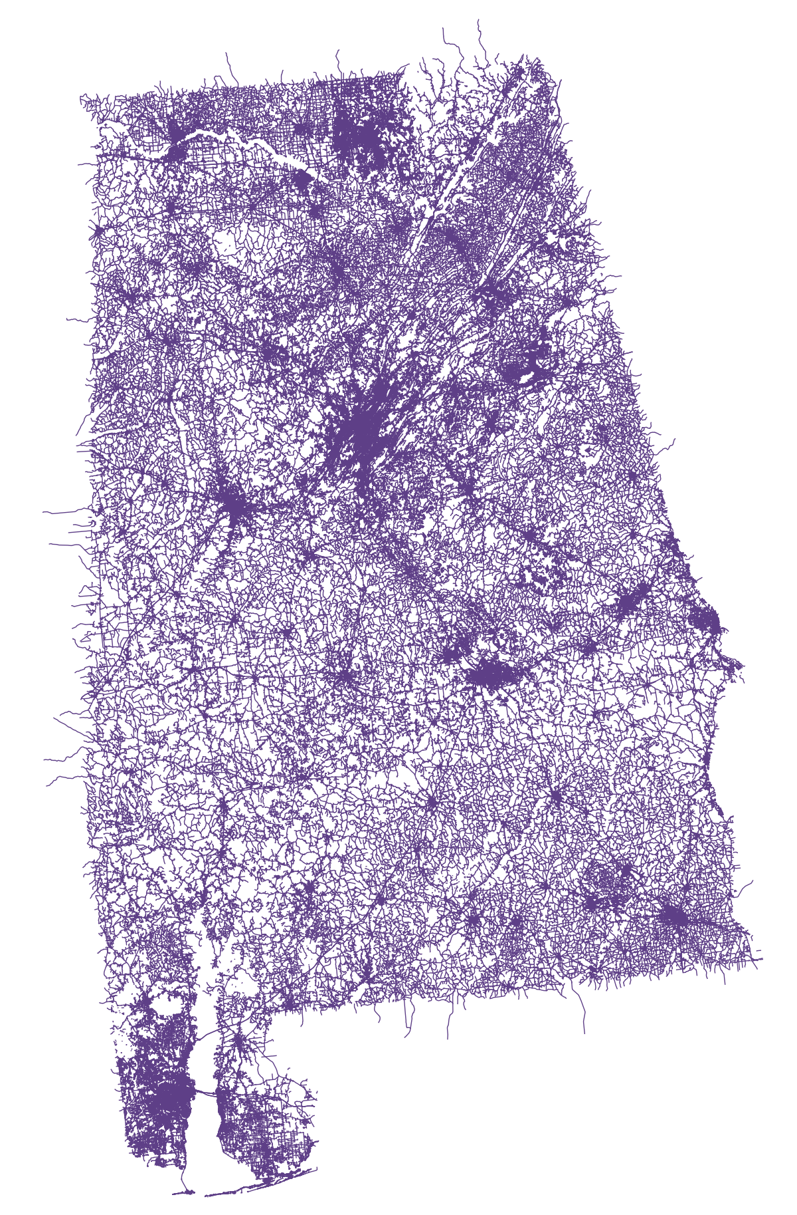
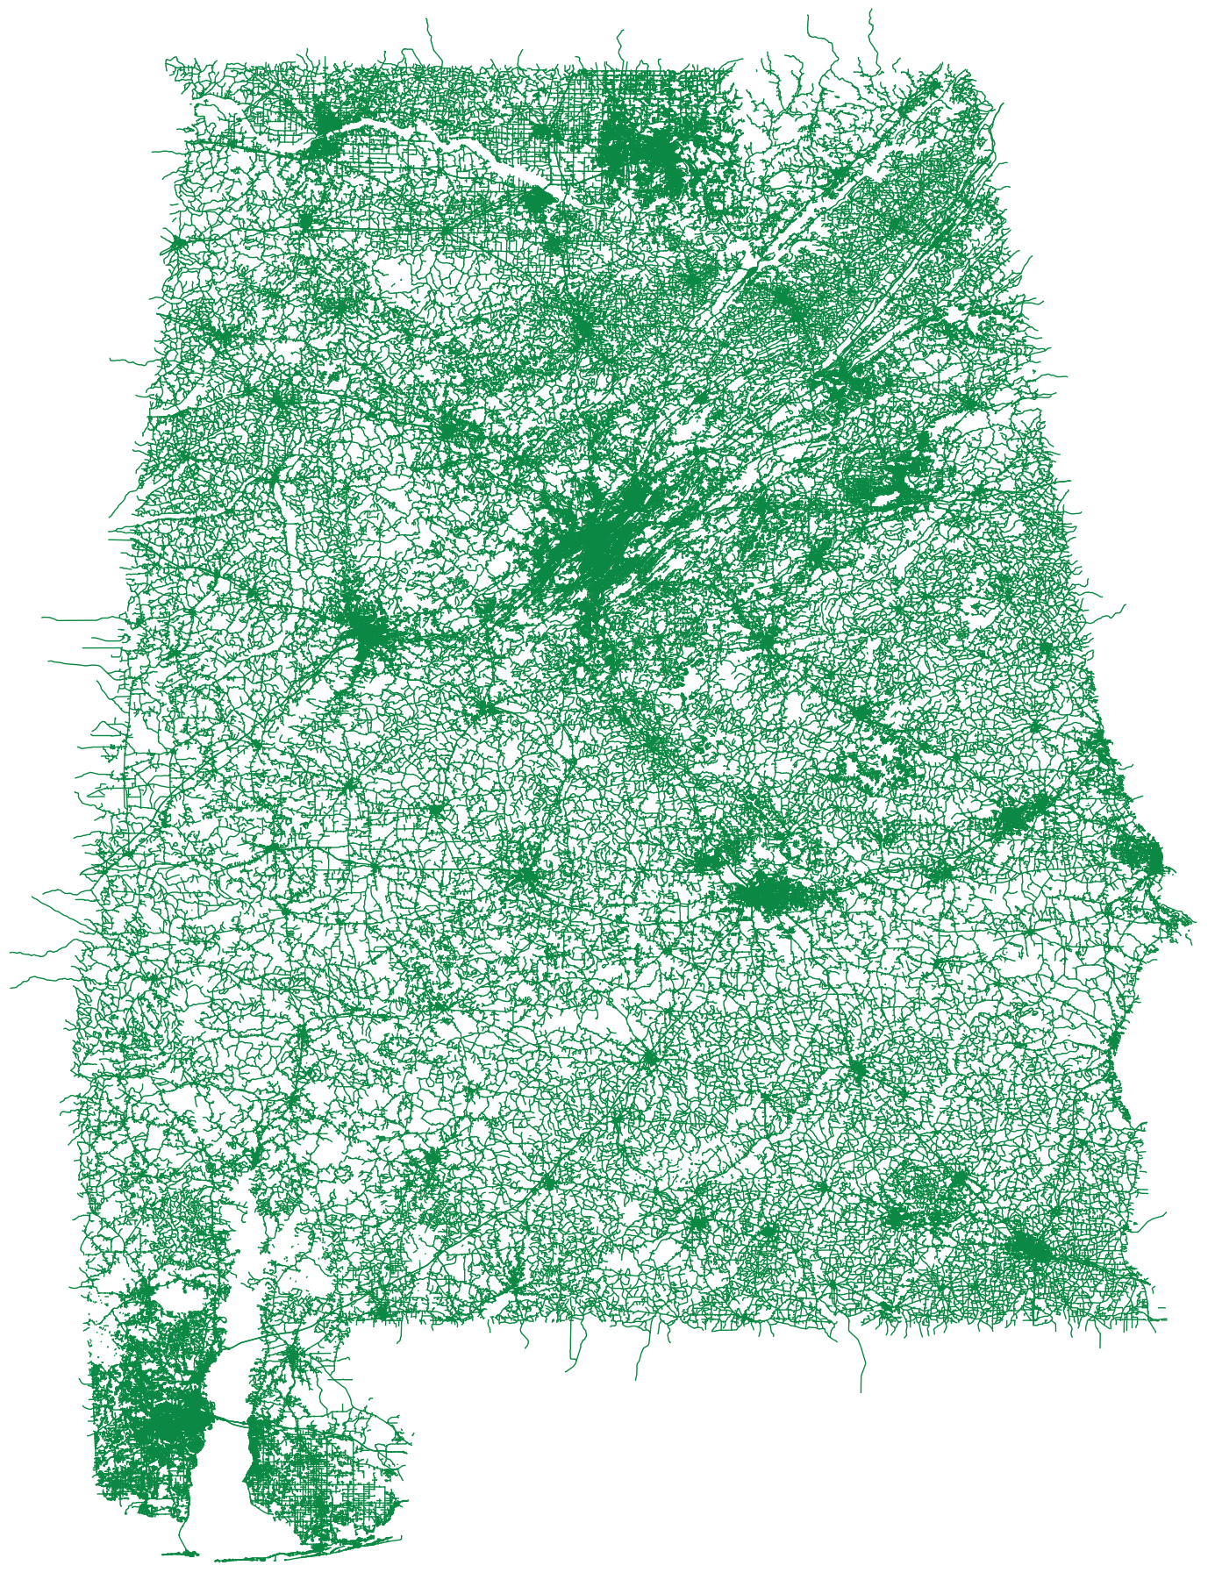
Edges – Pre-processing with PyQGIS
Reproject coordinates to North American Datum of 1983 (NAD83)
Distances calculated in meters
WGS84
NAD83

Slide 12
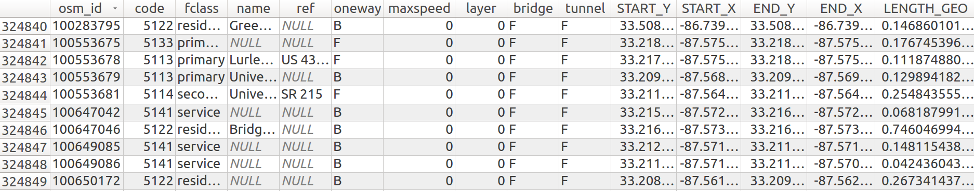
Edges – Pre-processing with PyQGIS
Add length (in miles)

Slide 13
Edges – Pre-processing with PyQGIS
Reproject back to WGS84 for later visualizations
NAD83
WGS84

Slide 14
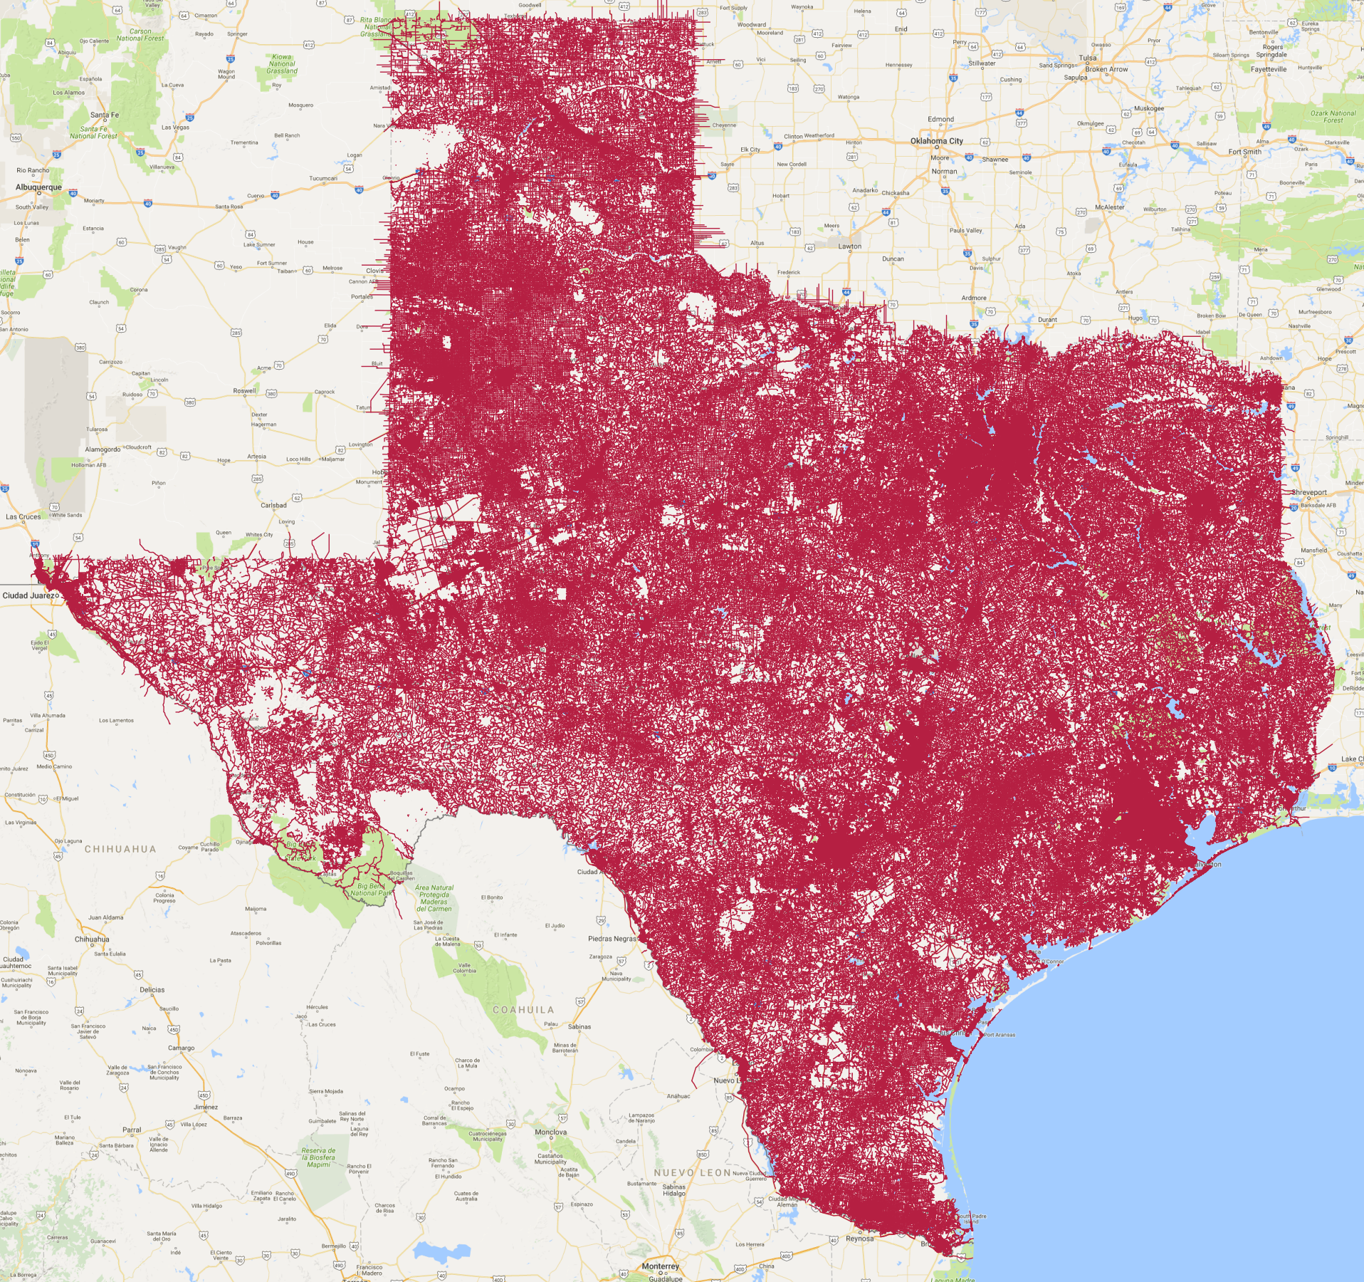
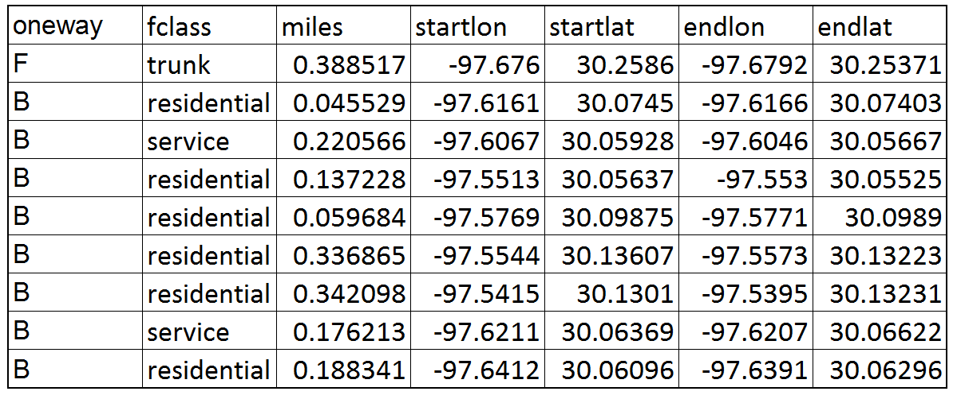
Edges – Convert to Pandas DataFrame
Shapefile module → convert shapefile to pandas dataframe
https://pypi.python.org/pypi/pyshp

Slide 15
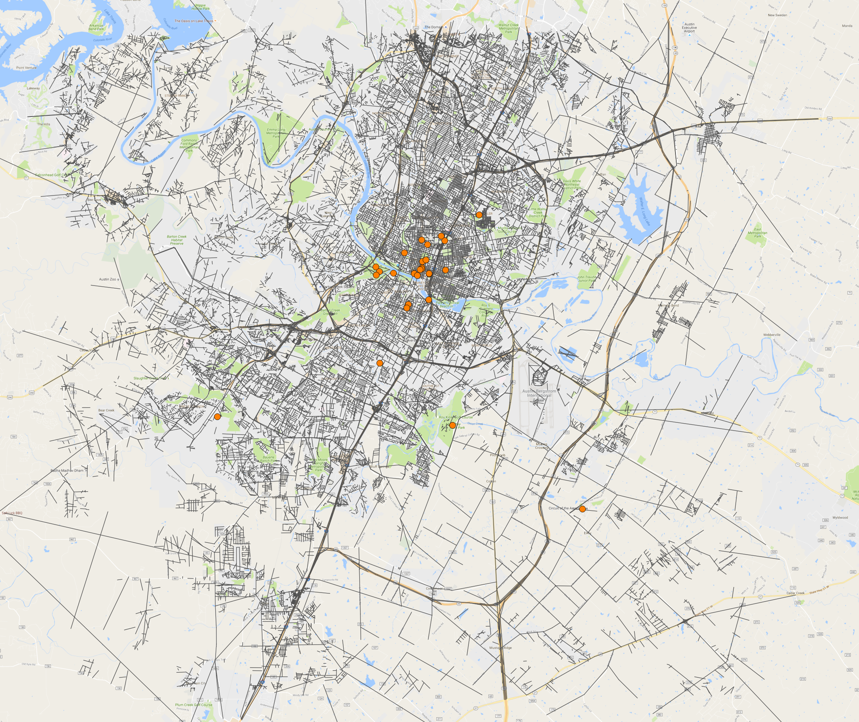
Edges – Clip Shapefile
GDAL/OGR → Clip edges shapefile to attractions extent
Shapely → Convert point latlons to Well-Known-Text
*Note:
GDAL - Geospatial Data Abstraction Library
OGR - OpenGIS Simple Features Reference Implementation
https://pypi.python.org/pypi/GDAL/
https://pypi.python.org/pypi/Shapely

Slide 16
Melissa’s stuff…

Slide 17
Stage 2: Optimization of Vacation Itinerary

Slide 18
Assumptions and Simplifications
Scheduling
Day begins and ends at the hotel
Daily activity time = 12 hours or less
Duration at locations = 2 hours
Rewards
Attraction ratings
Conversion constant = $10 per unit rating
Time value of money = $36/hr
http://www.forbes.com/sites/maggiemcgrath/2016/03/25/how-much-is-your-time-really-worth/#1ebc0afd408c
http://programs.clearerthinking.org/what_is_your_time_really_worth_to_you.html#.WDRRV_krJPY
Notes:
Based on a salary of $50k per year (~ $24 per hr for a 40 hour work week)

Slide 19
Assumptions and Simplifications
“Freeway” road speed = 65 mph
“Other” road speed = 40 mph

Slide 20
Optimization Problem Formulation
Objectives:
Maximize attractions visited
Implies: shortest path among attractions
Methods Considered
Computationally expensive
4.35 secs for one solution per attraction index
Assuming 4 attractions / day and 20 attractions
4.35 * (19*18*17*16) = 404,654 secs (~4.68 days)
Final Method
Savings Algorithm Based Heuristic Solution

Slide 21
Heuristic Procedure
Initial Itinerary
Start with initial attraction
Hotel
Attraction 1
Attraction 2
Attraction 3
Attraction 4
Attraction 5
Hotel
Attraction 2
Attraction 3
Attraction 4
Attraction 5
Hotel
Attraction 4
Hotel
Attraction 1
Attraction 1
Attraction 1
Attraction 4
Total Reward = 335
Hotel
Attraction 5
Attraction 2
Attraction 3
Attraction 4
Attraction 1
Hotel
Total Reward = 512

Slide 22
Heuristic Procedure
Check time for “solved” attractions
Repeat until Total Time < 12
Procedure assumption – Sample size = 5
Assuming 4 attractions / day and 20 attractions
4.35 * (19*18*17*16) = 404,654 secs ~= 4.68 days
Sample size = 5 → 4.35 * 4 * 5 = 87 secs ~= 1.45 mins
Hotel
Attraction 5
Total Time = Travel Time + (# of Attractions) * 2 < 12
Hotel
Attraction 5
Attraction 2
Attraction 3
Attraction 4
Attraction 1
Hotel

Slide 23
Literature Review
How do other people answer this problem? Tell us a little about how other people go about answering the problem you selected. This is important because it gives us a basis on which to think about the project you created.

Slide 24
How did you mathematically model the real world? How did you translate the realworld problem into a mathematical formulation?

Slide 25
Sudesh’s stuff…

Slide 26
Analysis Design. Tell us about the analysis you designed. What data did you use? What does your software do? How did you test that it works correctly? What are the key experiments / questions you answered using your software?
Perhaps talk about how we compared with Google Maps results to verify distances and travel times (compared to our outputs).

Slide 27
Analysis Results. Tell us the interesting results of your analysis. What are the insights you gained? Teach your audience about the things you discovered.

Slide 28
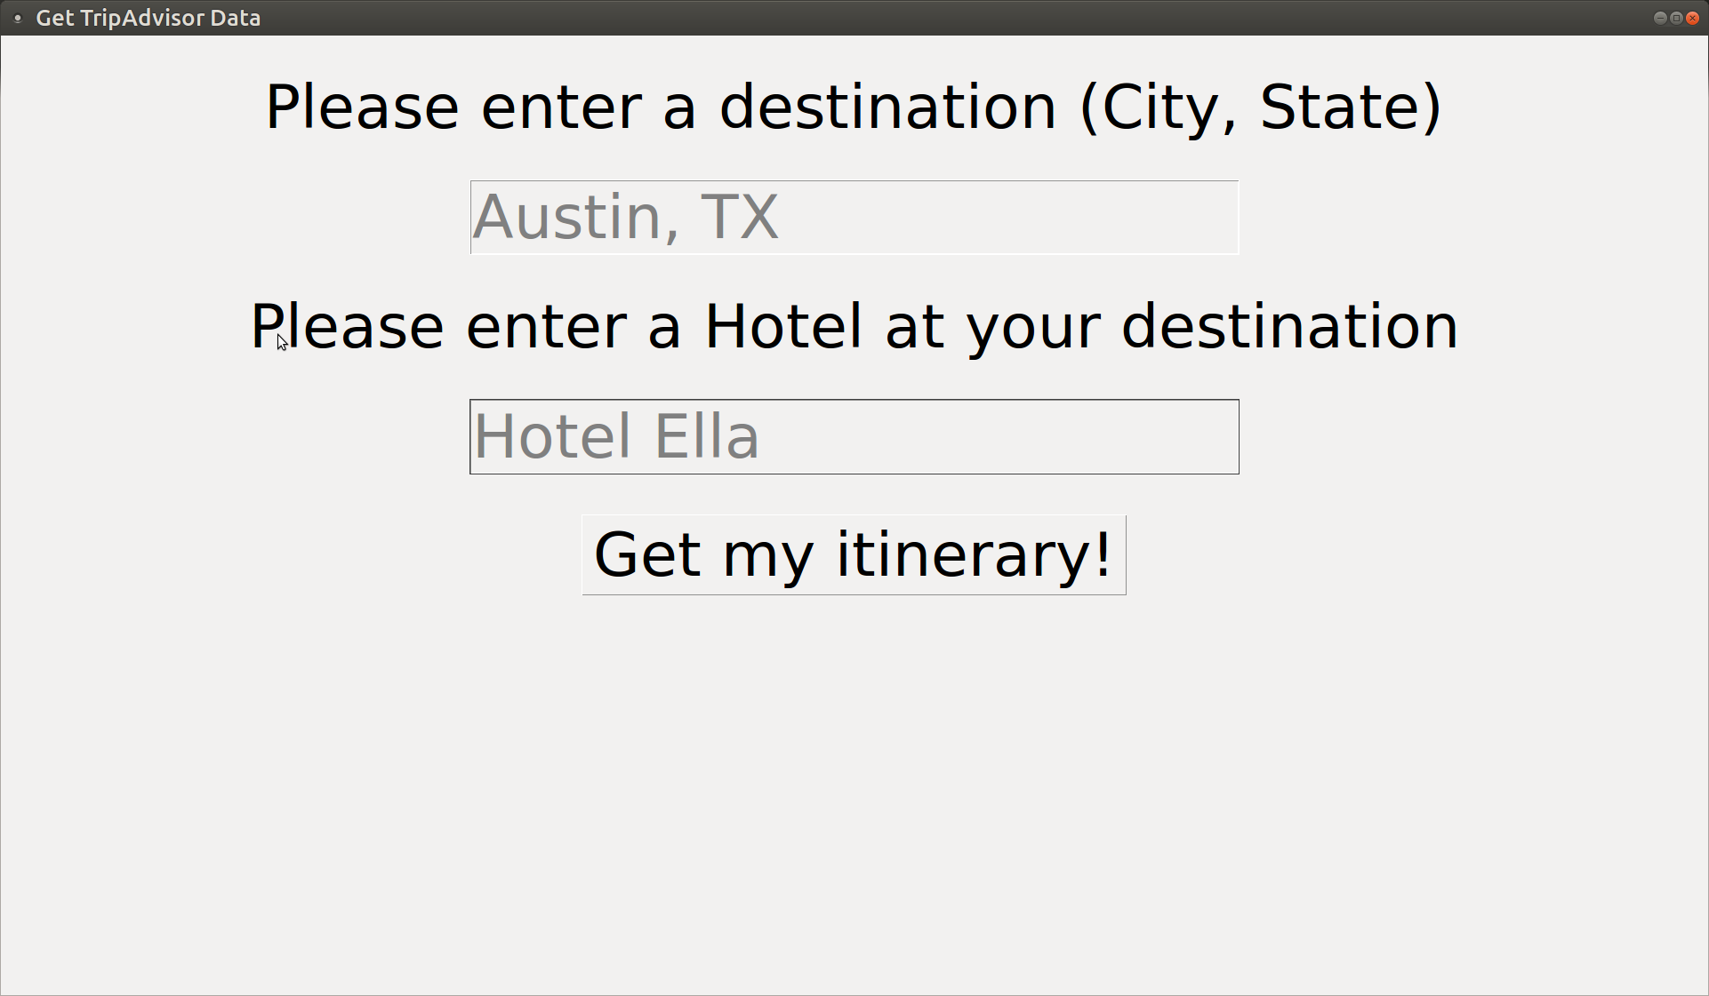
Calling the Script
Tkinter GUI
Pass arguments by calling python script via command-line
'python scrape.py –city=Austin –state=TX ' –base=Hotel_Ella’

Slide 29
Summary and Conclusion. Give us just one slide on the limitations of your analysis. In other words, if you had 3 additional months to work on this, what else would you have done to make the results better?
Limitations…
Limited to USA
Intended to make pip module, but lots of dependency requirements and a lot of data (shapefiles) needed to do analysis

Slide 30
Analysis Limitations
Result itinerary not “optimal,” but better than initial
Limited to cities in USA
Road dataset quality → Network quality
Identification of road speed approximation
Intended to make pip module, but lots of dependency requirements and a lot of data (shapefiles) needed to do analysis ??
Picture of the “bad” Tuscaloosa roads?

Slide 31
Future Work
Add restaurants to the algorithm
Improve conversion of rating to money value
Weight of rating for different attraction types
Extend to time-space network
QGIS output

